Slide 1
Chapter 33 – Macromedia® Flash™ 5: Building Interactive Animations
Outline
33.1 Introduction
33.2 Learning Flash with Hands-on Examples
33.2.1 Changing the Appearance of the Stage
33.2.2 Creating a Shape with the Oval Tool
33.2.3 Adding Text to a Button
33.2.4 Converting a Shape into a Symbol
33.2.5 Adding Keyframes
33.2.6 Editing Button Symbols
33.2.7 Using the Paint Bucket Tool
33.2.8 Using Test Movie to Verify Changes
33.2.9 Adding Layers to a Movie
33.2.10 Using Tweening to Animate Text
33.2.11 Adding a Text Field
33.2.12 Adding ActionScripting

Slide 2
Chapter 33 – Macromedia® Flash™ 5: Building Interactive Animations
Outline
33.3 Creating a Projector(.exe) File Using Publish
33.4 Manually Embedding a Flash Movie in a Web page
33.5 Using Flash for Special Effects
33.5.1 Importing and Manipulating Bitmaps
33.5.2 Using Masking to Create an Advertisement Banner
33.5.3 Adding Online Help to Your Forms
33.5.4 Adding Sound
33.5.5 Creating a Web-Site Introduction
33.6 Creating a Store Front
33.7 Using Loops and Functions
33.8 ActionScripts

Slide 3
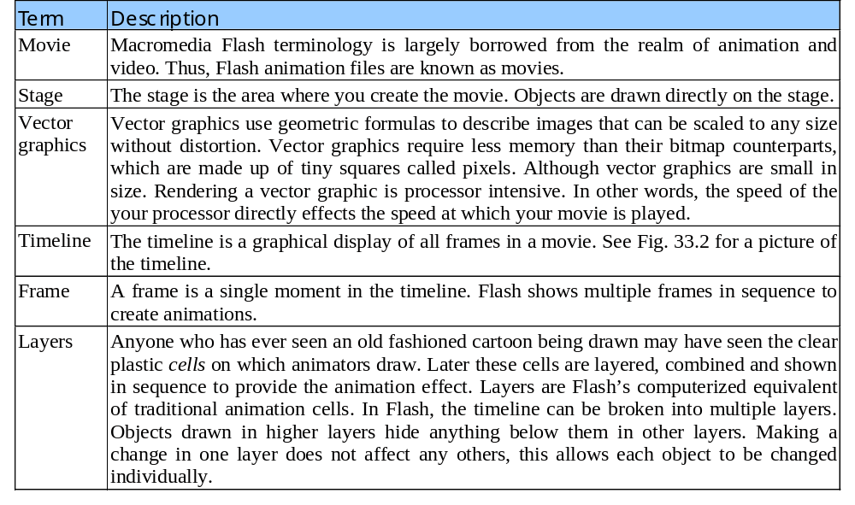
Fig 33.1

Slide 4
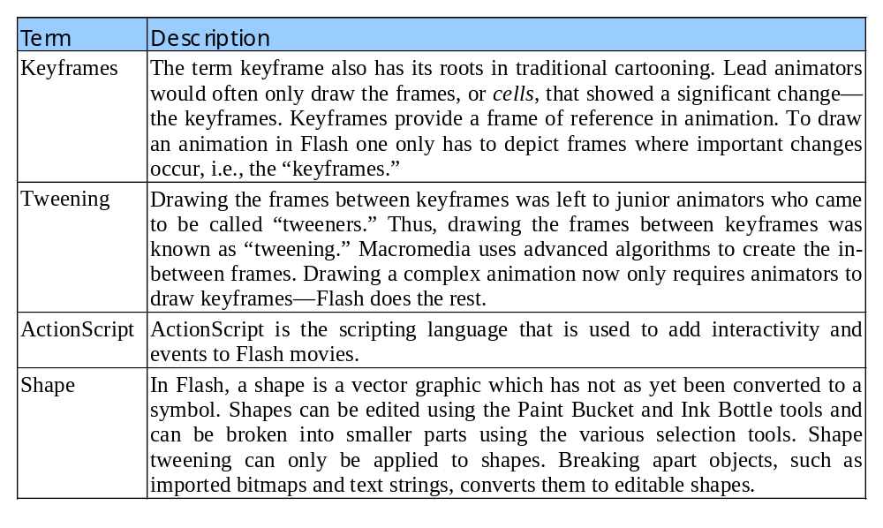
Fig 33.1

Slide 5
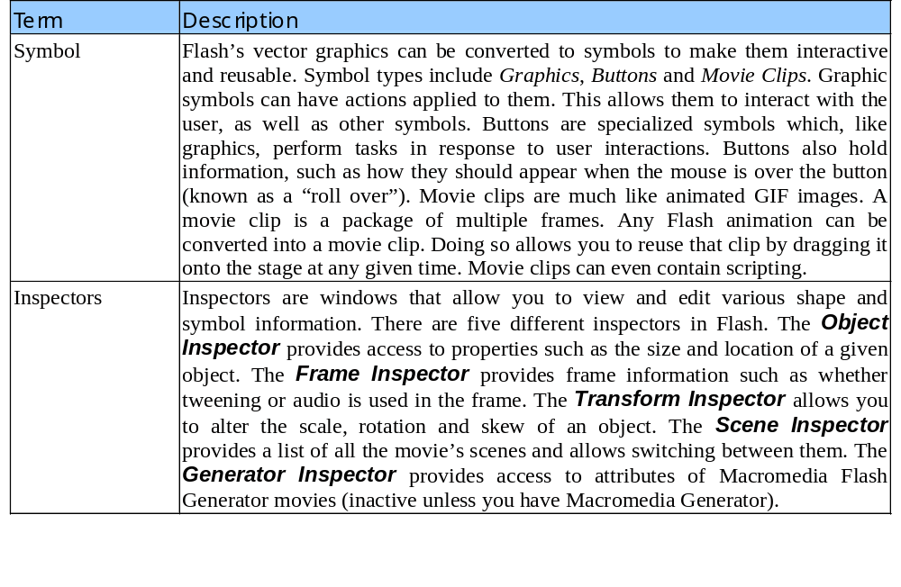
Fig 33.1

Slide 6
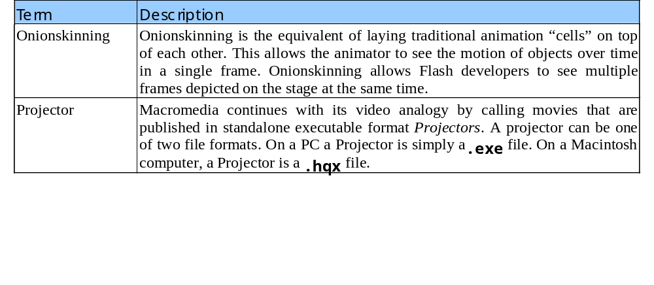
Fig 33.1

Slide 7
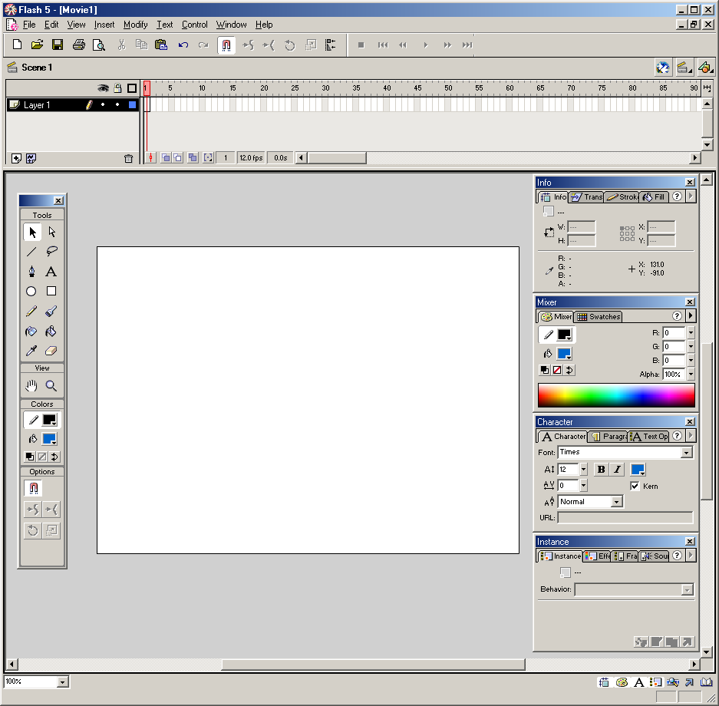
Fig 33.2
Layers
Timeline
Edit Symbols button
Standard Toolbar
Toolbox
Panels
Zoom Percentage
Stage
Panel Buttons
Status bar
Courtesy of Macromedia, Inc.

Slide 8

Fig 33.3
Arrow tool
Subselect tool
Line tool
Lasso tool
Pen tool
Text tool
Oval tool
Rectangle tool
Pencil tool
Brush tool
Ink bottle tool
Paint Bucket tool
Dropper tool
Eraser tool
Hand tool
Zoom out
Stroke Color Modifier
Fill Color Modifier
Tool Modifiers
Courtesy of Macromedia, Inc.

Slide 9
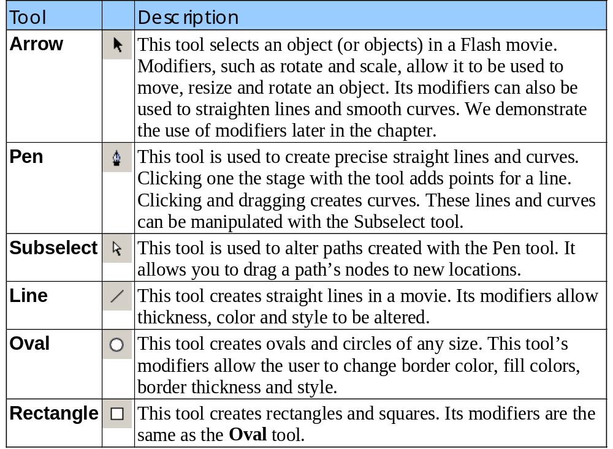
Fig 33.4

Slide 10
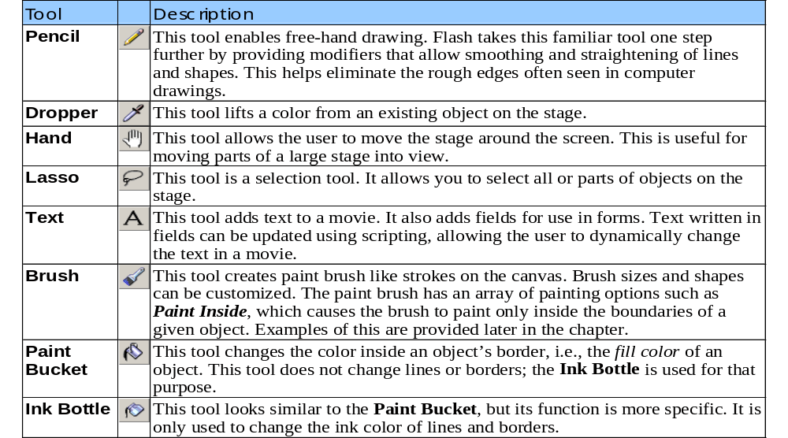
Fig 33.4

Slide 11
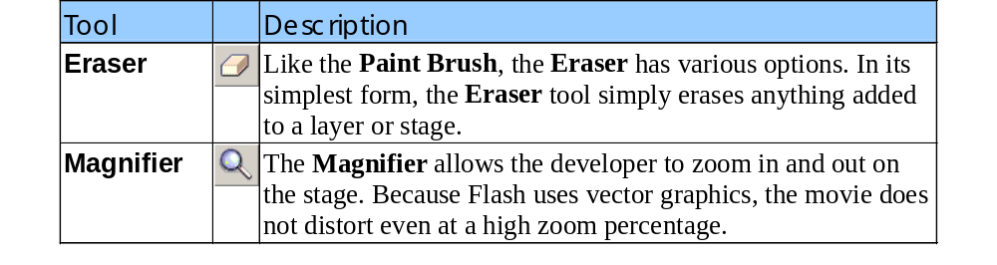
Fig 33.4

Slide 12
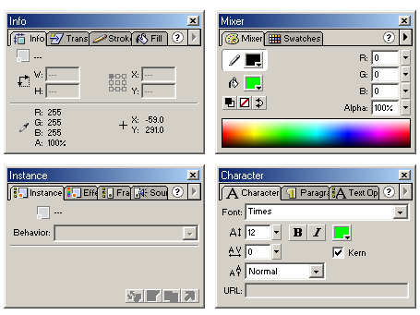
Fig 33.5
Info
Transform
Stroke
Fill
Instance
Effect
Frame
Sound
Swatches
Mixer
Text Options
Paragraph
Character
Courtesy of Macromedia, Inc.

Slide 13
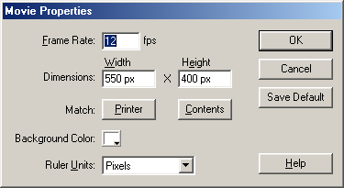
Fig 33.6
Courtesy of Macromedia, Inc.

Slide 14

Fig 33.7
Zoom in
Zoom out
Courtesy of Macromedia, Inc.

Slide 15

Fig 33.8
Line color
Fill color
Courtesy of Macromedia, Inc.

Slide 16
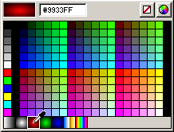
Fig 33.9
Hex edit text box
None buttons
Magnified color
Color swatches
Color packet button
Gradient swatches
Courtesy of Macromedia, Inc.

Slide 17
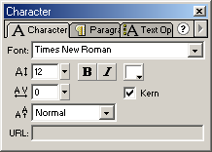
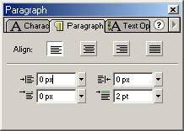
Fig 33.10
Font name
Font size
Font trackings
Baseline shifts
Link textbox
Font color
Font kerning
Left margin
Indent
Right indent
Line spacing
Courtesy of Macromedia, Inc.

Slide 18
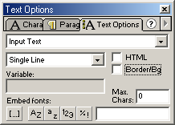
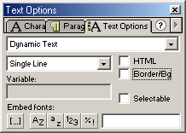
Fig 33.10
Text type pop-up menu
Line display pop-up menu
Variable name
Full font button
HTML check box
Border / Big check box
Max chars text box
Embed specific chars
Embed uppercase
Embed lowercase
Embed symbols
Embed numbers
Text type pop-up menu
Line display pop-up menu
Variable name
Full font button
HTML check box
Border / Big check box
Selectable check box
Embed specific chars
Embed uppercase
Embed lowercase
Embed symbols
Embed numbers
Courtesy of Macromedia, Inc.

Slide 19

Fig 33.11
Courtesy of Macromedia, Inc.

Slide 20
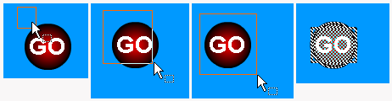
Fig 33.12
Courtesy of Macromedia, Inc.

Slide 21
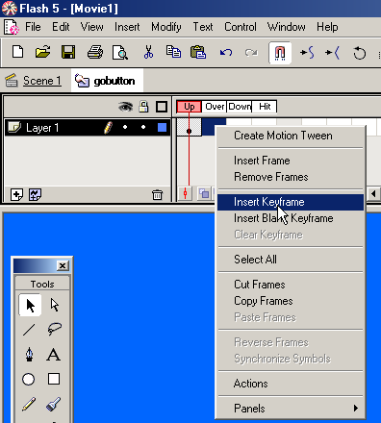
Fig 33.13
Courtesy of Macromedia, Inc.

Slide 22

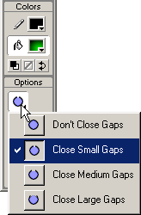
Fig 33.14
Fill color
Fill color
Gap size
Gap size
Lock fill
Courtesy of Macromedia, Inc.

Slide 23


Fig 33.15
Courtesy of Macromedia, Inc.

Slide 24
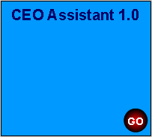
Fig 33.16
Courtesy of Macromedia, Inc.

Slide 25

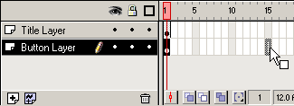
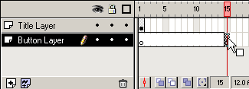
Fig 33.17
Courtesy of Macromedia, Inc.

Slide 26
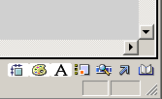
Fig 33.18
Info panel
Mixer panel
Character panel
Instance panel
Library window
Action panel
Movie explorer
Courtesy of Macromedia, Inc.

Slide 27
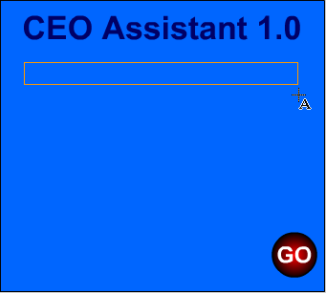
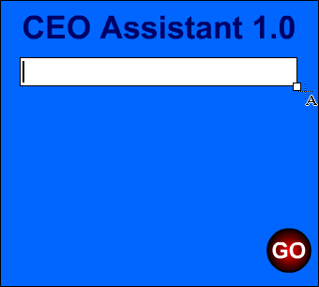
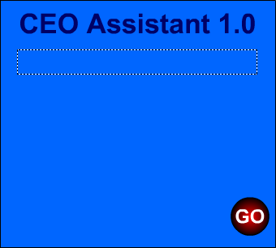
Fig 33.19
Courtesy of Macromedia, Inc.

Slide 28
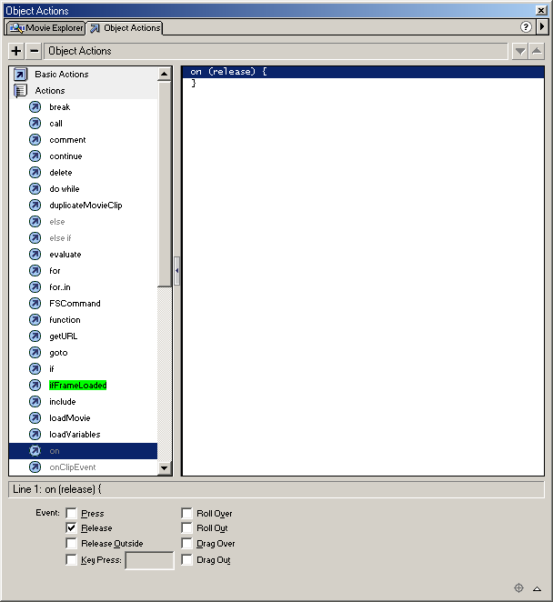
Fig 33.20
Add statement Remove statement
Courtesy of Macromedia, Inc.
Statements Statement options Actionscript window

Slide 29
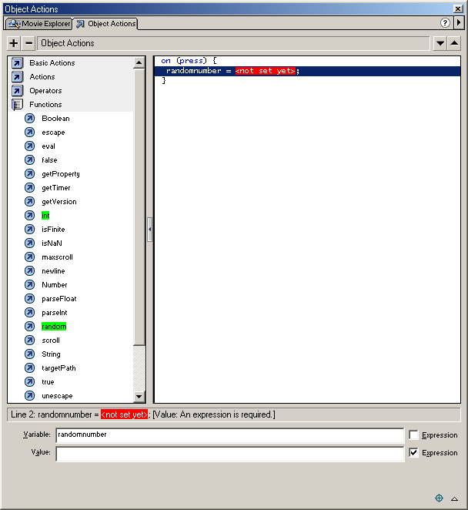
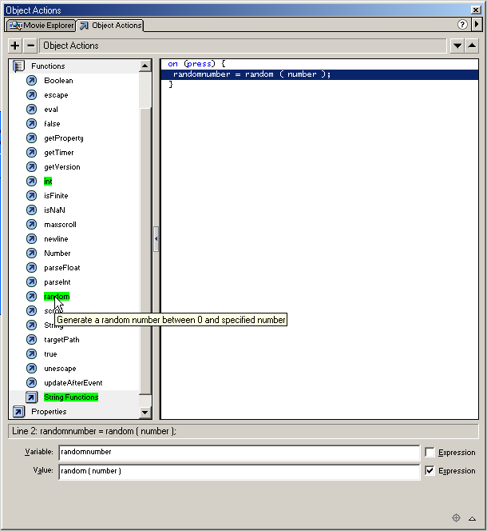
Fig 33.21
Courtesy of Macromedia, Inc.

Slide 30
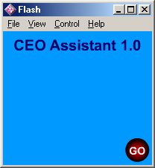
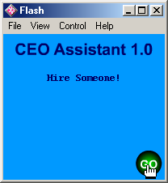
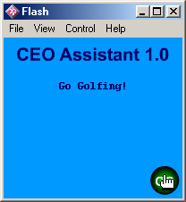
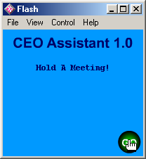

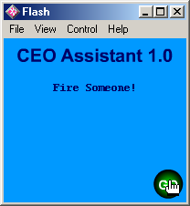
Fig 33.22
Courtesy of Macromedia, Inc.

Slide 31
1 <HTML>
2
3 <!-- Fig. 33.23: Embedding a Flash Movie into a Web site -->
4 <!-- ceoassist.html -->
Fig 33.23
5
6 <!DOCTYPE HTML PUBLIC "-//W3C//DTD HTML 4.0 Transitional//EN">
7 <HTML>
8
9 <HEAD>
10 <TITLE>
11 Adding Flash to your Web site
12 </TITLE>
13 </HEAD>
14
15 <BODY>
16
17 <!-- The following OBJECT tag tells the Microsoft -->
18 <!-- Internet Explorer browser to play the Flash Movie -->
19 <!-- and where to find the Flash Player plug-in if it -->
20 <!-- is not installed. -->
21
22 <OBJECT CLASSID = "clsid:D27CDB6E-AE6D-11cf-96B8-444553540000"
23 CODEBASE =
24 "http://download.macromedia.com/pub/shockwave/cabs
25 /flash/swflash.cab#version=4,0,2,0">
26 <PARAM NAME = "Movie" VALUE = "ceoassist.swf">
27
28 <!-- The following EMBED tag tells the Netscape Navigator -->
29 <!-- browser to play the Flash Movie and where to find the -->
30 <!-- Flash Player plug-in if it is not installed. -->

Slide 32
31
32 <EMBED SRC = "ceoassist.swf" PLUG-INSPAGE =
33 "http://www.macromedia.com/shockwave/download
34 /index.cgi?P1_Prod_Version=ShockwaveFlash">
Fig 33.23
35 </EMBED>
36
37 <NOEMBED>
38 This Web site contains the CEO Assistant 1.0 Flash movie.
39 You must have the Flash PLayer plug-in to see the Flash movie.
40 </NOEMBED>
41
42 </OBJECT>
43
44 </BODY>
45 </HTML>

Slide 33
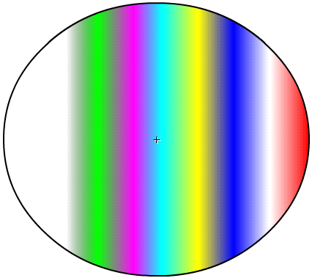
Fig 33.24
Courtesy of Macromedia, Inc.

Slide 34
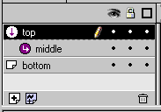
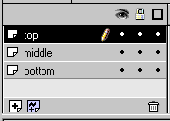
Fig 33.25
Courtesy of Macromedia, Inc.

Slide 35

Fig 33.26
Courtesy of Macromedia, Inc.

Slide 36

Fig 33.27
Courtesy of Macromedia, Inc.

Slide 37

Fig 33.28
Courtesy of Macromedia, Inc.

Slide 38

Fig 33.29
Courtesy of Macromedia, Inc.

Slide 39
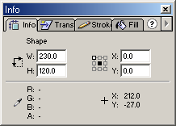
Fig 33.30
Registration Selection Tool
Courtesy of Macromedia, Inc.

Slide 40



Fig 33.31
Frame 5
Frame 10
Frame 1
Courtesy of Macromedia, Inc.

Slide 41
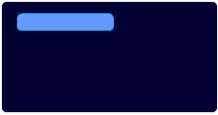
Fig 33.32
Courtesy of Macromedia, Inc.

Slide 42
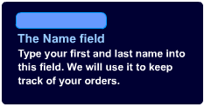
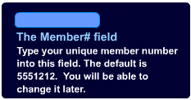
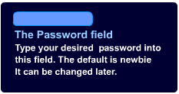
Fig 33.33
Courtesy of Macromedia, Inc.

Slide 43
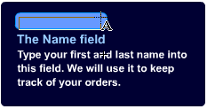
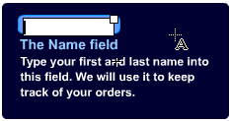
Fig 33.34
Courtesy of Macromedia, Inc.

Slide 44

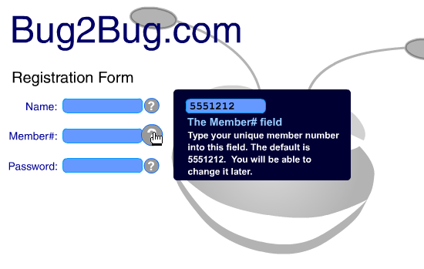
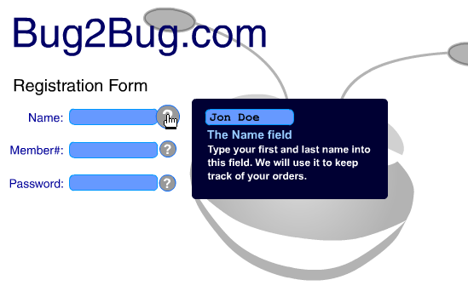
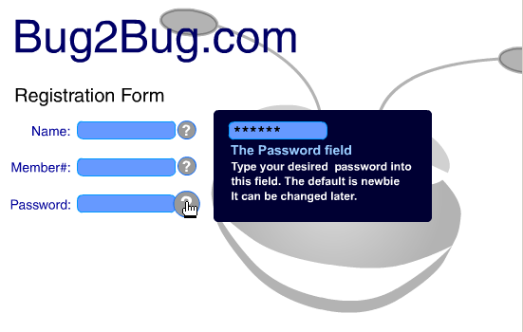
Fig 33.35
Courtesy of Macromedia, Inc.

Slide 45
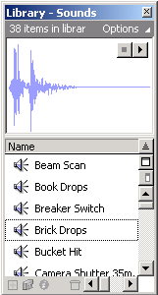
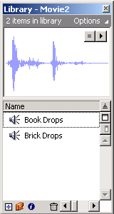
Fig 33.36
Courtesy of Macromedia, Inc.

Slide 46
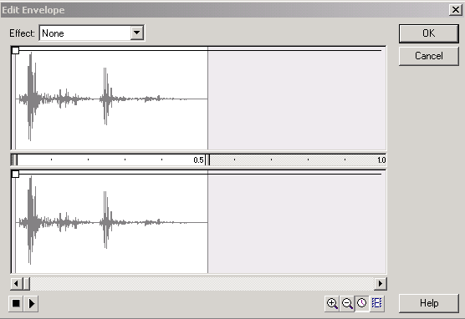
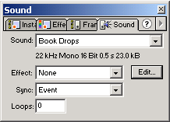
Fig 33.37
Courtesy of Macromedia, Inc.

Slide 47

Fig 33.38
Sound clip
Courtesy of Macromedia, Inc.

Slide 48

Fig 33.39
Courtesy of Macromedia, Inc.

Slide 49

Fig 33.40
Courtesy of Macromedia, Inc.

Slide 50


Fig 33.41
Courtesy of Macromedia, Inc.

Slide 51

Fig 33.42
Courtesy of Macromedia, Inc.

Slide 52

Fig 33.43
Courtesy of Macromedia, Inc.

Slide 53

Fig 33.44
Courtesy of Macromedia, Inc.

Slide 54

Fig 33.45
Courtesy of Macromedia, Inc.

Slide 55

Fig 33.46
Vertical alignment
Horizontal alignment
Courtesy of Macromedia, Inc.

Slide 56

Fig 33.47
Courtesy of Macromedia, Inc.

Slide 57

Fig 33.48
Courtesy of Macromedia, Inc.

Slide 58

Fig 33.49
Courtesy of Macromedia, Inc.

Slide 59

Fig 33.50
Courtesy of Macromedia, Inc.

Slide 60

Fig 33.51
Courtesy of Macromedia, Inc.

Slide 61

Fig 33.52
Text sausageQuantity plainQuantity
pepperoniQuantity
plainTotal
pepperoniTotal
sausageTotal
hawaiianTotal
veggieTotal
baconTotal
anchovyTotal
subTotal
delivery
total
buttons veggieQuantity anchovyQuantity
hawaiianQuantity baconQuantity
Courtesy of Macromedia, Inc.

Slide 62


Fig 33.53
Courtesy of Macromedia, Inc.

Slide 63

Fig 33.54
Courtesy of Macromedia, Inc.

Slide 64

Fig 33.55
Courtesy of Macromedia, Inc.

Slide 65

Fig 33.56

Slide 66
1 onClipEvent ( load ) {
2
3 // This function is used to duplicate the bubble movie
4 // clip, place it randomly on the stage, change its size
Fig 33.57
5 // and lower its alpha value.
6 function createBubbles ()
7 {
8
9 // Initialize variables.
10 randomX = 0;
11 randomY = 0;
12
13 // This variable keeps track of all the movies created
14 // while the movie plays.
15 total += Number( _root.toolbar.numBubbles );
16
17 // Here, count is initialized, the number of repetitions
18 // this for loop completes is decided by user inputs and
19 // count is incremented.
20 for ( count = 1; count <= total; count++ ) {
21
22 // Get random values for location of each movie clip.
23 randomX = Number( random( 550 ) ) + 50;
24 randomY = Number( random( 400 ) ) + 500;
25 newScale = Number( random( 200 ) ) + 50;
26
27 // This action creates new movie clips based on
28 // the value of count.
29 duplicateMovieClip ("_root.bubble", "bubble" add count,
30 count );
31

Slide 67
32 // The following code sets the attributes for each
33 // movie clip that is created.
34 setProperty( "_root.bubble" add count, _x, randomX );
35 setProperty( "_root.bubble" add count, _y, randomY );
Fig 33.57
36 setProperty( "_root.bubble" add count, _alpha,
37 Number( random( 50 ) ) + 25 );
38 setProperty( "_root.bubble" add count, _xscale, newScale );
39 setProperty( "_root.bubble" add count, _yscale, newScale );
40 }
41 }
42
43 // This function is used to remove the duplicated movie clips
44 // from the screen.
45 function deleteBubbles ()
46 {
47
48 // Here, count2 is initialized, the number of repetitions
49 // this for loop completes is decided by user inputs and
50 // count2 is incremented.
51 for ( count2 = 1; count2 <= total; count2++ ) {
52
53 // This action removes the new movie clips based on
54 // the value of count2.
55 removeMovieClip ( "_root.bubble" add count2 );
56 }
57 total = 0;
58 }
59
60 // This function is used to increase the scale value of the
61 // new bubble instances.

Slide 68
62 function scalerUp ()
63 {
64 for ( scaler = 1; scaler < count; scaler++ ) {
65
66 // Before increasing the size of the instance, _xscale and
Fig 33.57
67 // _yscale values need to be obtained.
68 oldX = getProperty( "_root.bubble" add scaler, _xscale );
69 oldY = getProperty( "_root.bubble" add scaler, _yscale );
70
71 // The following code increases the scale properties for the
72 // new bubble instances.
73 setProperty( "_root.bubble" add scaler, _xscale,
74 oldX + 5 );
75 setProperty( "_root.bubble" add scaler, _yscale,
76 oldY + 5 );
77 }
78 }
79
80 // This function decreases the scale property for each bubble
81 // instance.
82 function scalerDown ()
83 {
84 for (scaler = 1; scaler < count; scaler++ ) {
85 oldX = getProperty( "_root.bubble" add scaler, _xscale );
86 oldY = getProperty( "_root.bubble" add scaler, _yscale );
87 setProperty( "_root.bubble" add scaler, _xscale,
88 oldX - 5 );
89 setProperty( "_root.bubble" add scaler, _yscale,
90 oldY - 5 );
91 }
92 }
93 }

Slide 69

Fig 33.58
Courtesy of Macromedia, Inc.

Slide 70
1 onClipEvent ( enterFrame ) {
2
3 // This first if statement is used to make sure the original
4 // instance of the bubble is not seen on the screen.
5 if ( this._name != "bubble" )
Fig 33.59
6 {
7
8 // This if statement is used to check if the instance of
9 // the bubble is not located on the screen.
10 if ( this._y <= 0 || this._x <= 0 || this._x >= 600 )
11 {
12
13 // If the instance is not located on the screen, it
14 // is placed at a random location below the screen to
15 // begin its animation to the top of the screen again.
16 this._y = 500;
17 this._x = this._x + ( random( 600 ) - this._x );
18 } else {
19
20 // If the instance is located on the screen, it is moved up
21 // side-to-side at random intervals.
22 this._y = this._y - ( random( 30 ) ) - 1;
23 this._x = this._x + ( random( 30 ) ) - 15;
24 }
25 }
26
27 // This is used to advance the movie clip to its second frame
28 // where the sound clip of the bubble popping is located.
29 if ( this._y <= 0 )
30 {
31 this.gotoAndPlay( 2 );
32 }
33 }

Slide 71

Fig 33.60

Slide 72

Fig 33.60

